Slide 1
Examining Alzheimer’s Disease biomarkers with linear modeling
Annie Bryant
OLET 5608 Final Presentation
18 May 2022

Slide 2
Presentation Outline
Brief background on Alzheimer’s Disease (AD) biomarkers
Overview of open AD dataset used
Linear modeling approach – evaluation of assumptions and performance
Results and comparing models
Conclusions, limitations, and future implications for AD research

Slide 3
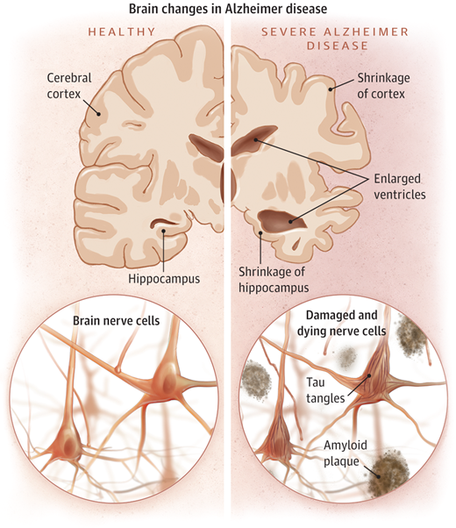
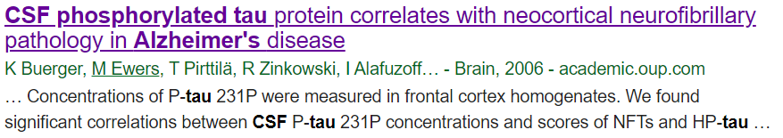
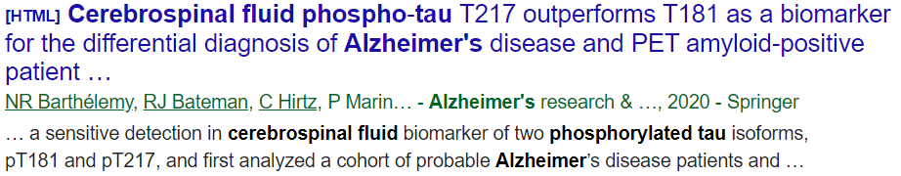
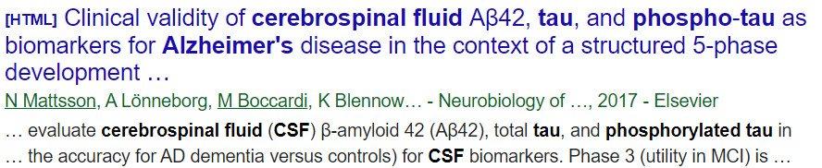
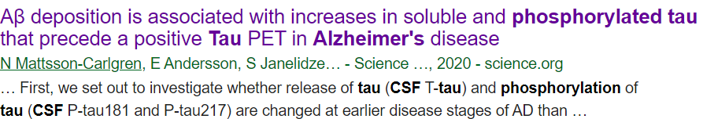
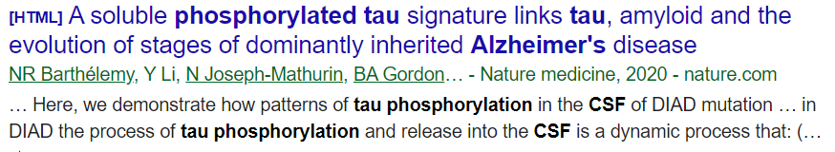
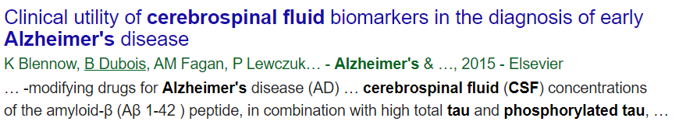
Understanding Alzheimer’s Disease (AD) Biomarkers
Question: can we understand the cognitive and neurobiological factor(s) driving AD-related changes in cerebrospinal fluid (CSF) hyperphosphorylated tau (PTAU) levels?
Image source: Jin (2015)¹

Slide 4

Leveraging open-access AD biomarker data
Alzheimer’s Disease Neuroimaging Initiative (ADNI)
Data is open to the research community
Predictor variables are diverse
Cognitive: ADAS11, ADAS13, CDRSB, MMSE
Demographic : Age, Gender, Education, Marital Status, Race
Genetic: APOE4
Structural MRI: Entorhinal, Fusiform, Hippocampus, ICV, MidTemp, Ventricles, WholeBrain
PET: FDG
CSF: ABETA
N = 19 predictor variables
N = 1 outcome (CSF PTAU)
ADNI is a longitudinal multi-center study that collects clinical, neuroimaging, genetic, and biochemical biomarkers to enable early detection and monitoring of Alzheimer’s Disease (AD)².
I chose to use the “ADNIMERGE” table, which can be downloaded directly from the ADNI repository or accessed via the ADNIMERGE R package³.
N = 701 subjects

Slide 5
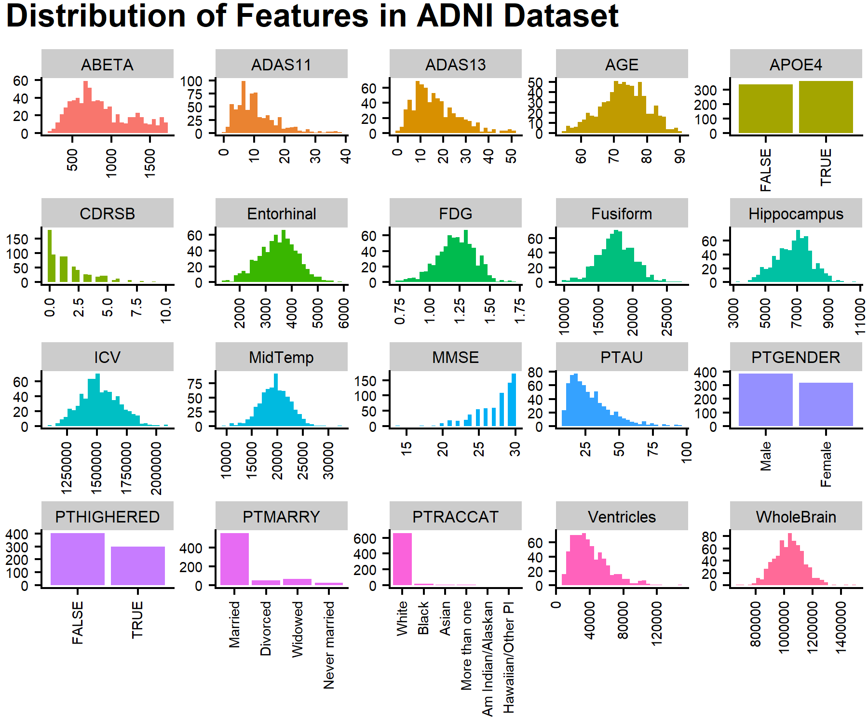
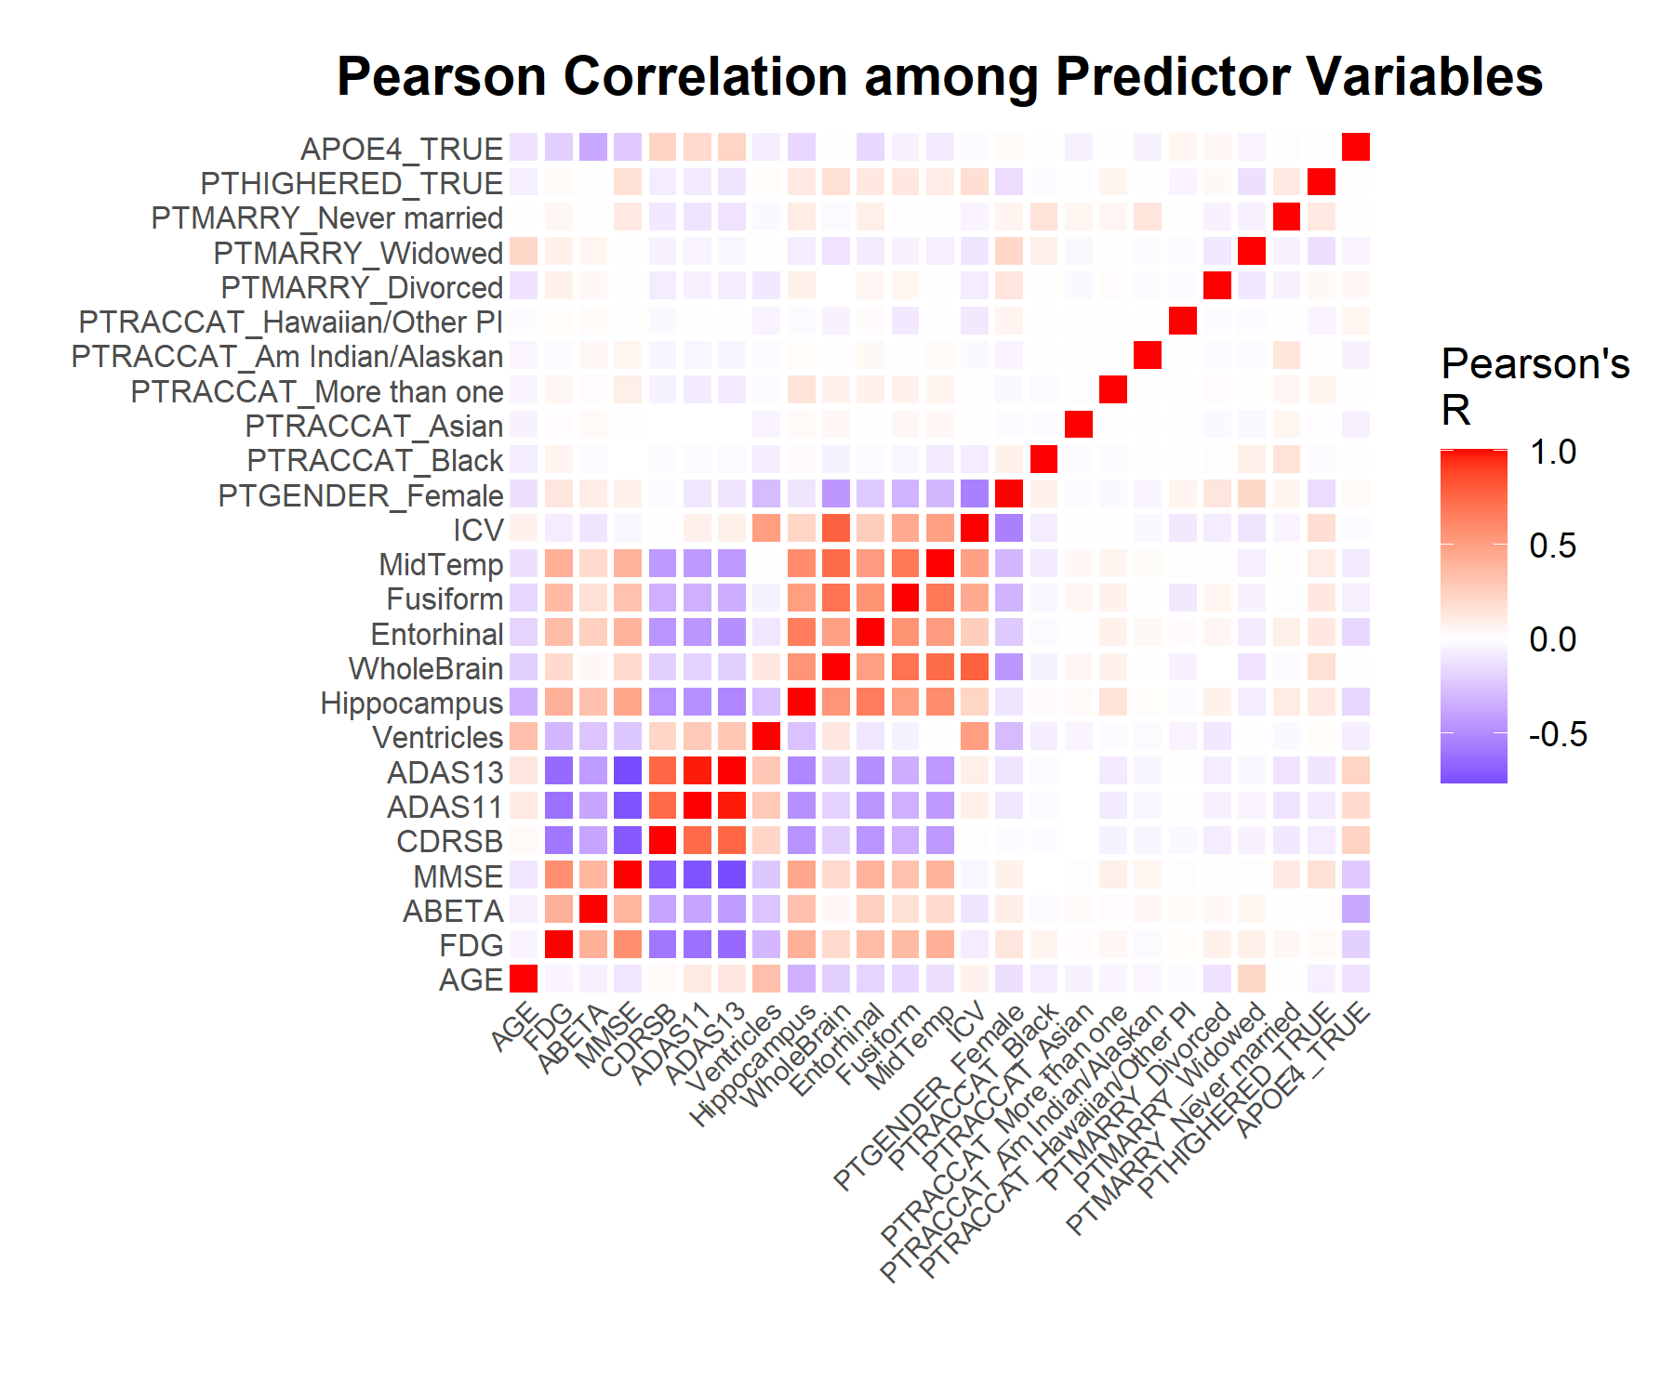
Exploring predictor and outcome variables

Slide 6
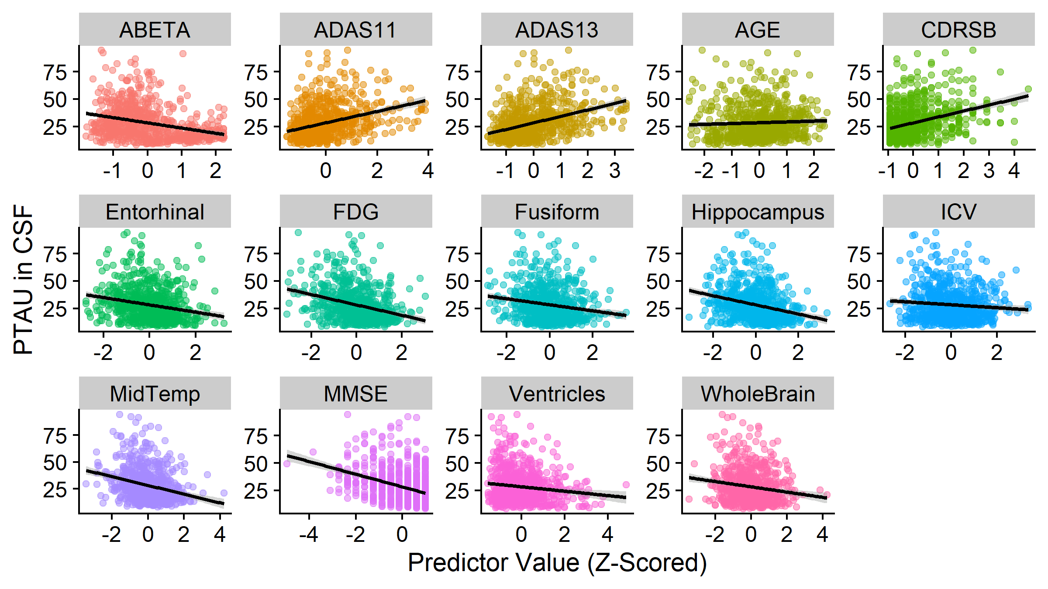
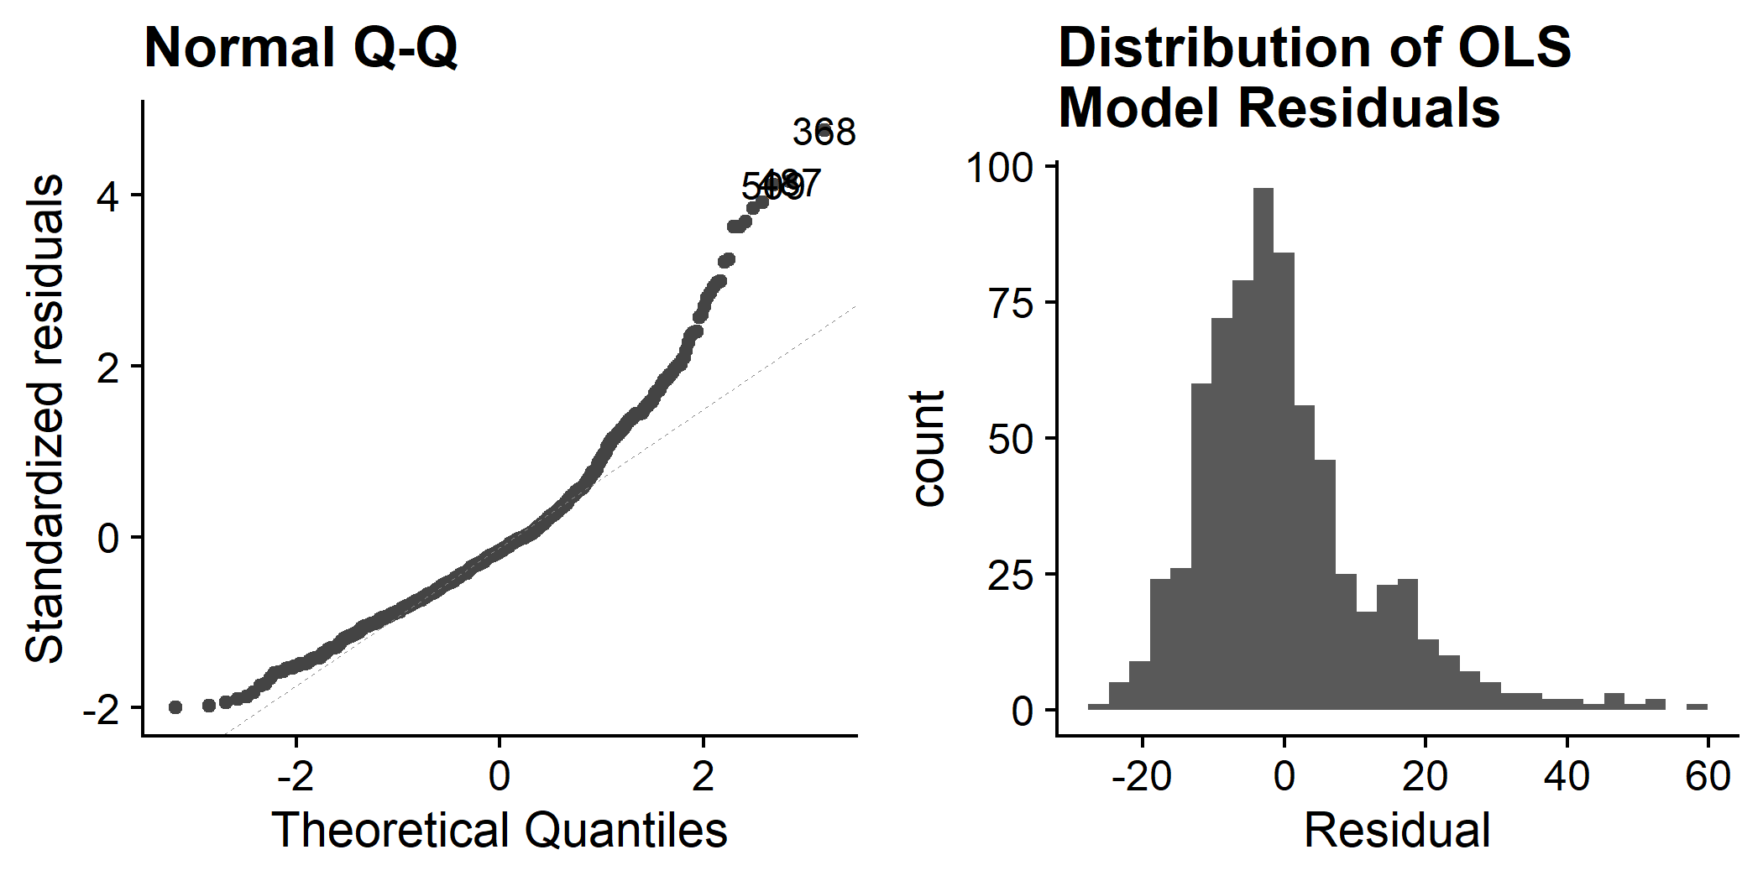
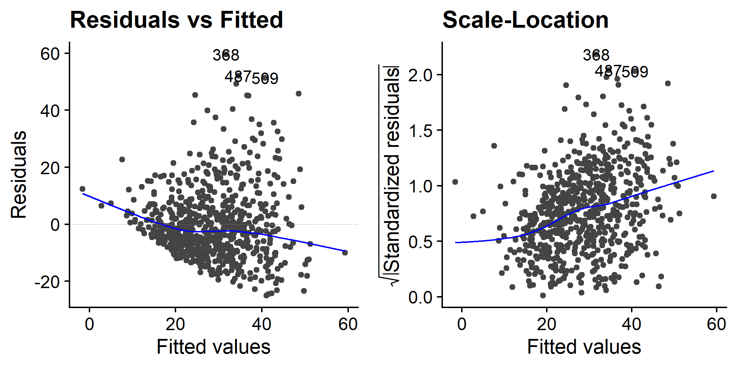

Testing the core assumptions of a linear model
1. Linear relationship to outcome variable
2. Normal distribution of residuals
Shapiro-Wilk test (p<2.2e-16)
3. Constant variance of residuals
4. Independence of observations
Breusch-Pagan test (p=2.672e-05)

Slide 7
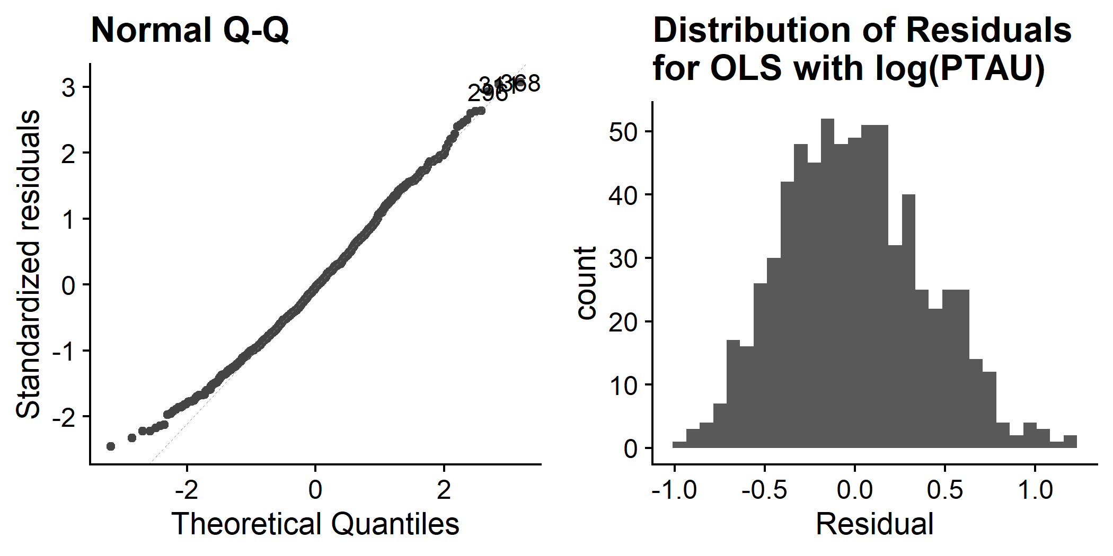
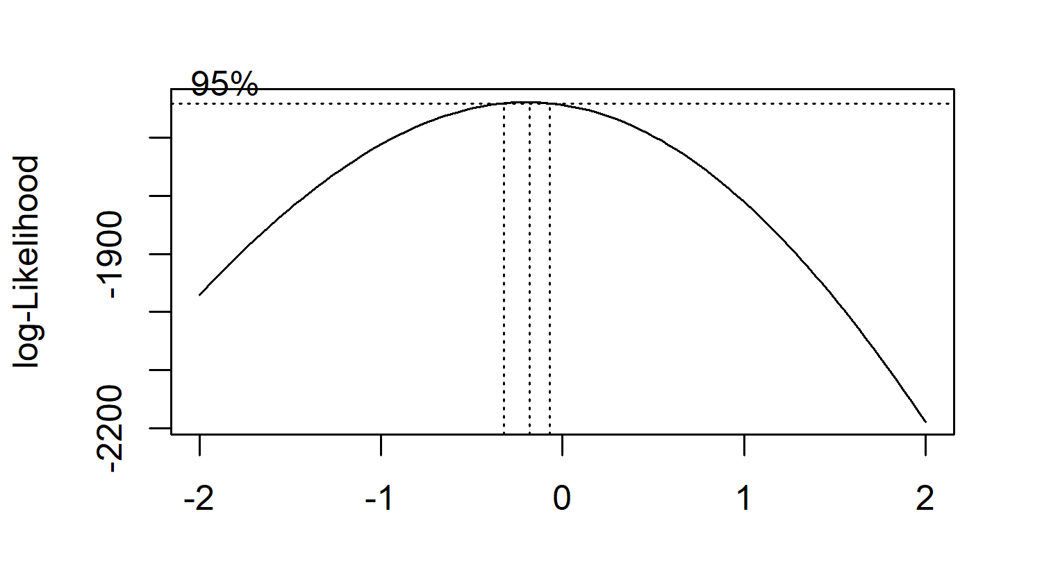
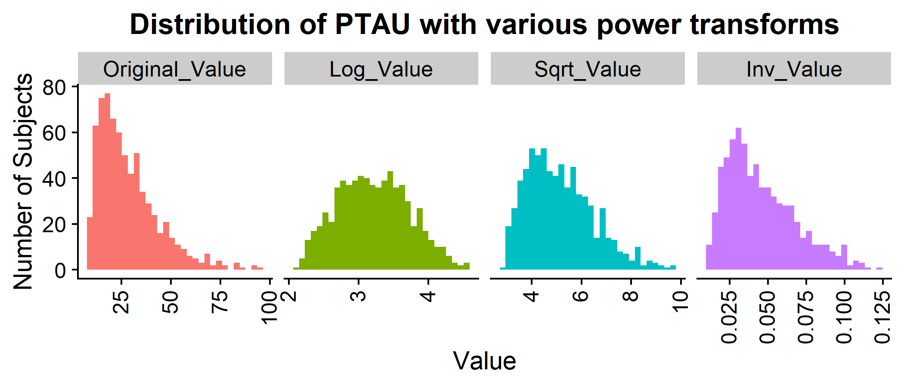
Mitigating assumption violations: non-normal residual distribution
Shapiro-Wilk test: p<2.2e-16
Shapiro-Wilk test: p = 0.001995
Box-Cox Power Transformation
λ = 0
λ = 0.5
λ = -1

Slide 8

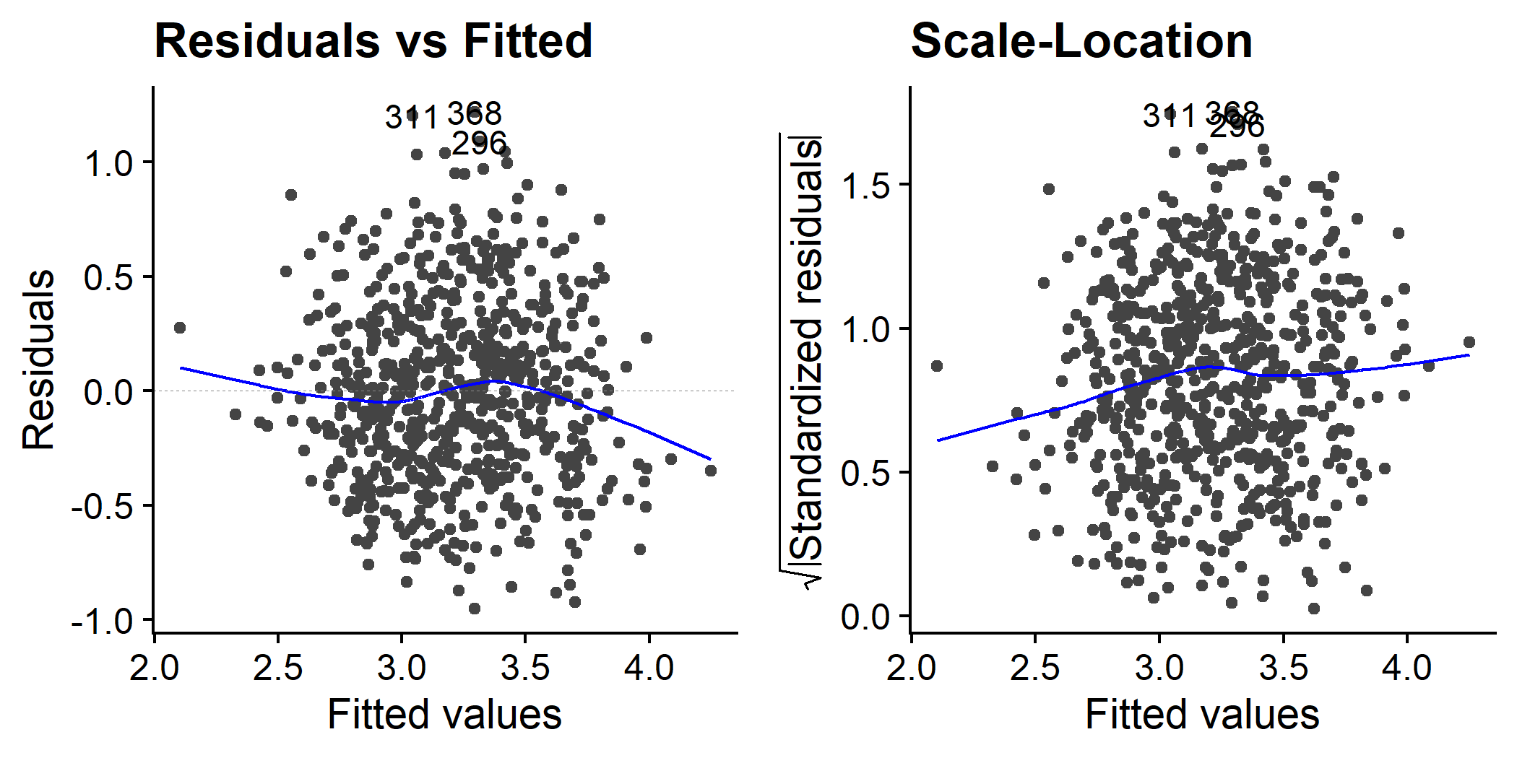
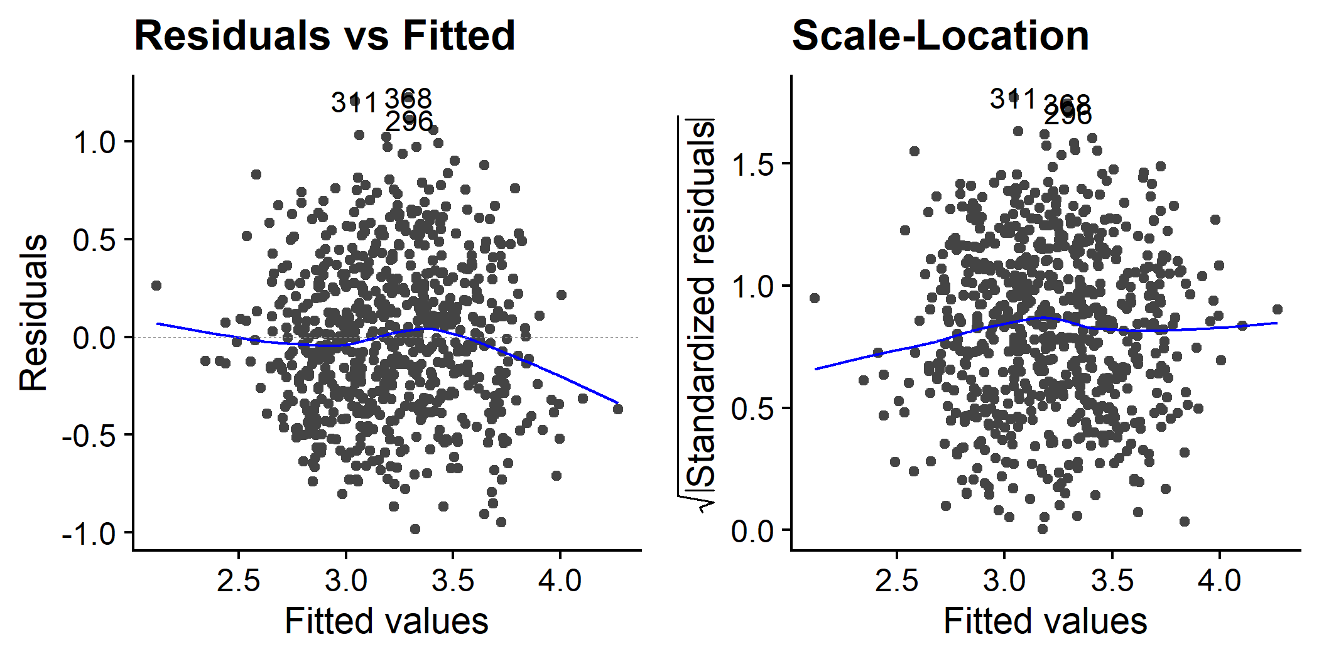
Mitigating assumption violations: heteroscedasticity
Method 1: Weighted least squares (WLS) regression
Method 2: Heteroscedasticity-robust standard errors
Equation source⁴
Breusch-Pagan test: p=3.295e-06
Term | OLS | OLS with Robust Estimator
ADAS13 | 0.339*** (0.078) | 0.339*** (0.083)
APOE4_TRUE | 0.207*** (0.035) | 0.207*** (0.037)
PTGENDER_Female | 0.111* (0.04) | 0.111* (0.039)
AGE | 0.093*** (0.019) | 0.093*** (0.02)
ICV | 0.055 (0.034) | 0.055 (0.031)
Entorhinal | 0.031 (0.023) | 0.031 (0.023)
WholeBrain | 0.021 (0.039) | 0.021 (0.039)
Fusiform | 0.012 (0.024) | 0.012 (0.024)
PTHIGHERED_TRUE | 0.01 (0.033) | 0.01 (0.032)
CDRSB | 0.005 (0.026) | 0.005 (0.03)
`PTMARRY_Never married` | -0.003 (0.086) | -0.003 (0.09)
Hippocampus | -0.034 (0.026) | -0.034 (0.027)
FDG | -0.037 (0.022) | -0.037 (0.022)
PTMARRY_Widowed | -0.038 (0.055) | -0.038 (0.059)
MidTemp | -0.041 (0.027) | -0.041 (0.027)
ABETA | -0.066** (0.019) | -0.066** (0.018)
PTMARRY_Divorced | -0.067 (0.06) | -0.067 (0.059)
MMSE | -0.072* (0.026) | -0.072 (0.028)
PTRACCAT_Asian | -0.132 (0.144) | -0.132 (0.226)
PTRACCAT_Black | -0.147 (0.092) | -0.147 (0.102)
Ventricles | -0.187*** (0.022) | -0.187*** (0.021)
ADAS11 | -0.241** (0.072) | -0.241* (0.075)
`PTRACCAT_More than one` | -0.27* (0.137) | -0.27* (0.105)
`PTRACCAT_Am Indian/Alaskan` | -0.322 (0.29) | -0.322 (0.215)
`PTRACCAT_Hawaiian/Other PI` | -0.375 (0.29) | -0.375* (0.158)
Breusch-Pagan test: p=3.295e-06
Original OLS
Log(PTAU)
Breusch-Pagan test: p=0.01294
Log(PTAU)+ WLS
Breusch-Pagan test: p<2.2e-16

Slide 9
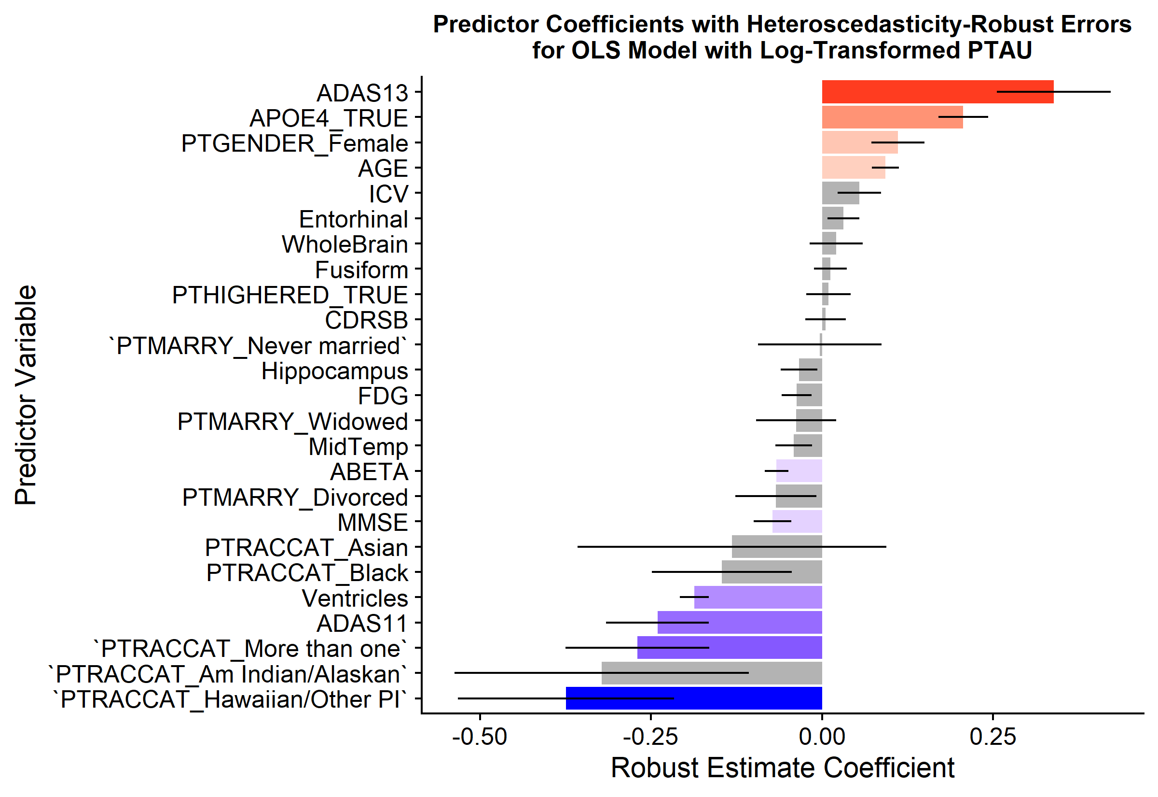
Modeling PTAU levels in the CSF using a subset of predictors
ADAS13, APOE4 allele, Female, Age
Hawaiian/Pacific Islander, More than one race, ADAS11, Ventricle volume, MMSE score, CSF ABETA level
Not significant
R² = 0.4001,
Adjusted R² = 0.3779

Slide 10
Conclusions and limitations
Key takeaways
Limitations
Follow-up research
ADAS13 cognitive score and the presence of at least APOE4 allele are most strongly associated with higher CSF PTAU, while multiple racial backgrounds, ADAS11 score, and ventricle volume have the strongest negative associations with CSF PTAU.
Class imbalances mean that some binarized factor variables represent only a small fraction of the whole population (e.g. PTRACCAT_Hawaiian/Other PI = 9 participants).
An adjusted R² of ~37% means the majority of variance is not explained by the current predictor terms.
Do the strong associations between racial backgrounds persist with more diverse study populations?
Why might ventricular volume be inversely related to CSF PTAU levels when both are positively associated with disease progression?

Slide 11
References
Jin, J. (2015). Alzheimer disease. JAMA, 313(14), 1488-1488.
Mueller, S. G., Weiner, M. W., Thal, L. J., Petersen, R. C., Jack, C. R., Jagust, W., ... & Beckett, L. (2005). Ways toward an early diagnosis in Alzheimer’s disease: the Alzheimer’s Disease Neuroimaging Initiative (ADNI). Alzheimer's & Dementia, 1(1), 55-66.
ADNI Team (2022). ADNIMERGE: Alzheimer’s Disease Neuroimaging Initiative. R package version 0.0.1. https://adni.bitbucket.io/index.html
Ford, C. (2020). Understanding robust standard errors. Lecture Notes, The University of Virginia. https://data.library.virginia.edu/understanding-robust-standard-errors/
Thank you for your attention ☺

